Slide 1

Security Isolation for System
Zeyu Mi

Slide 2
What is system isolation?
An entity may encounter failures or even be malicious
System isolation
  Contains effects of failures
  Performance fairness
Unit of isolation
  Process
  Virtual Machine
  Or smaller entities

Slide 3
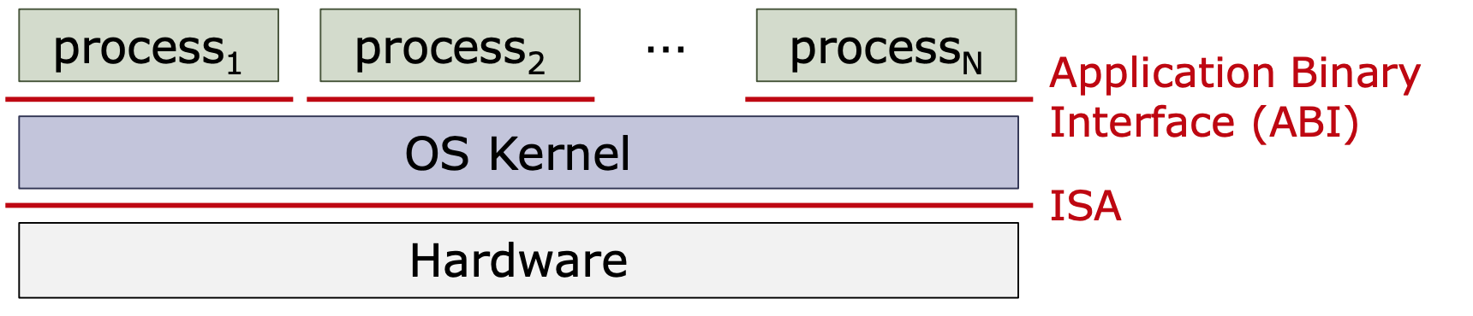
Operating system (OS) and its Goals
Resource Management
  OS controls how processes share hardware (CPU, memory, storage, network, etc.)
Abstraction
  Hide underline details
  Provide usable interfaces
Protection and Privacy
  Process cannot access other process data

Slide 4
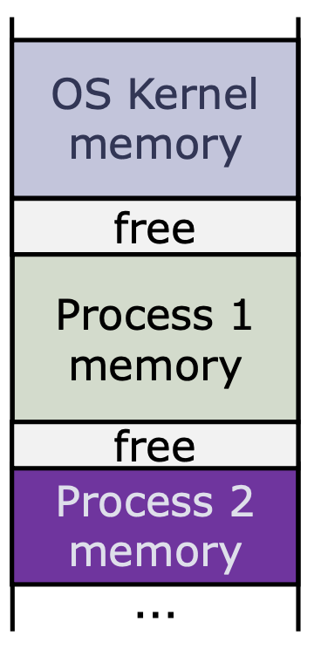
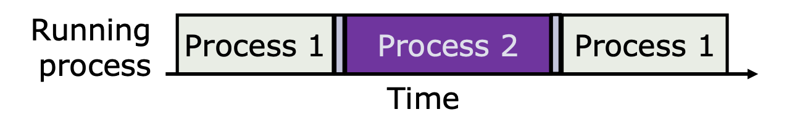
Process Abstraction
Each process has a private address space
  Provided by OS
  Cannot access other process spaces
The OS kernel schedules processes into cores
  Each process has a scheduling time slice
A process can invoke OS services via system calls

Slide 5
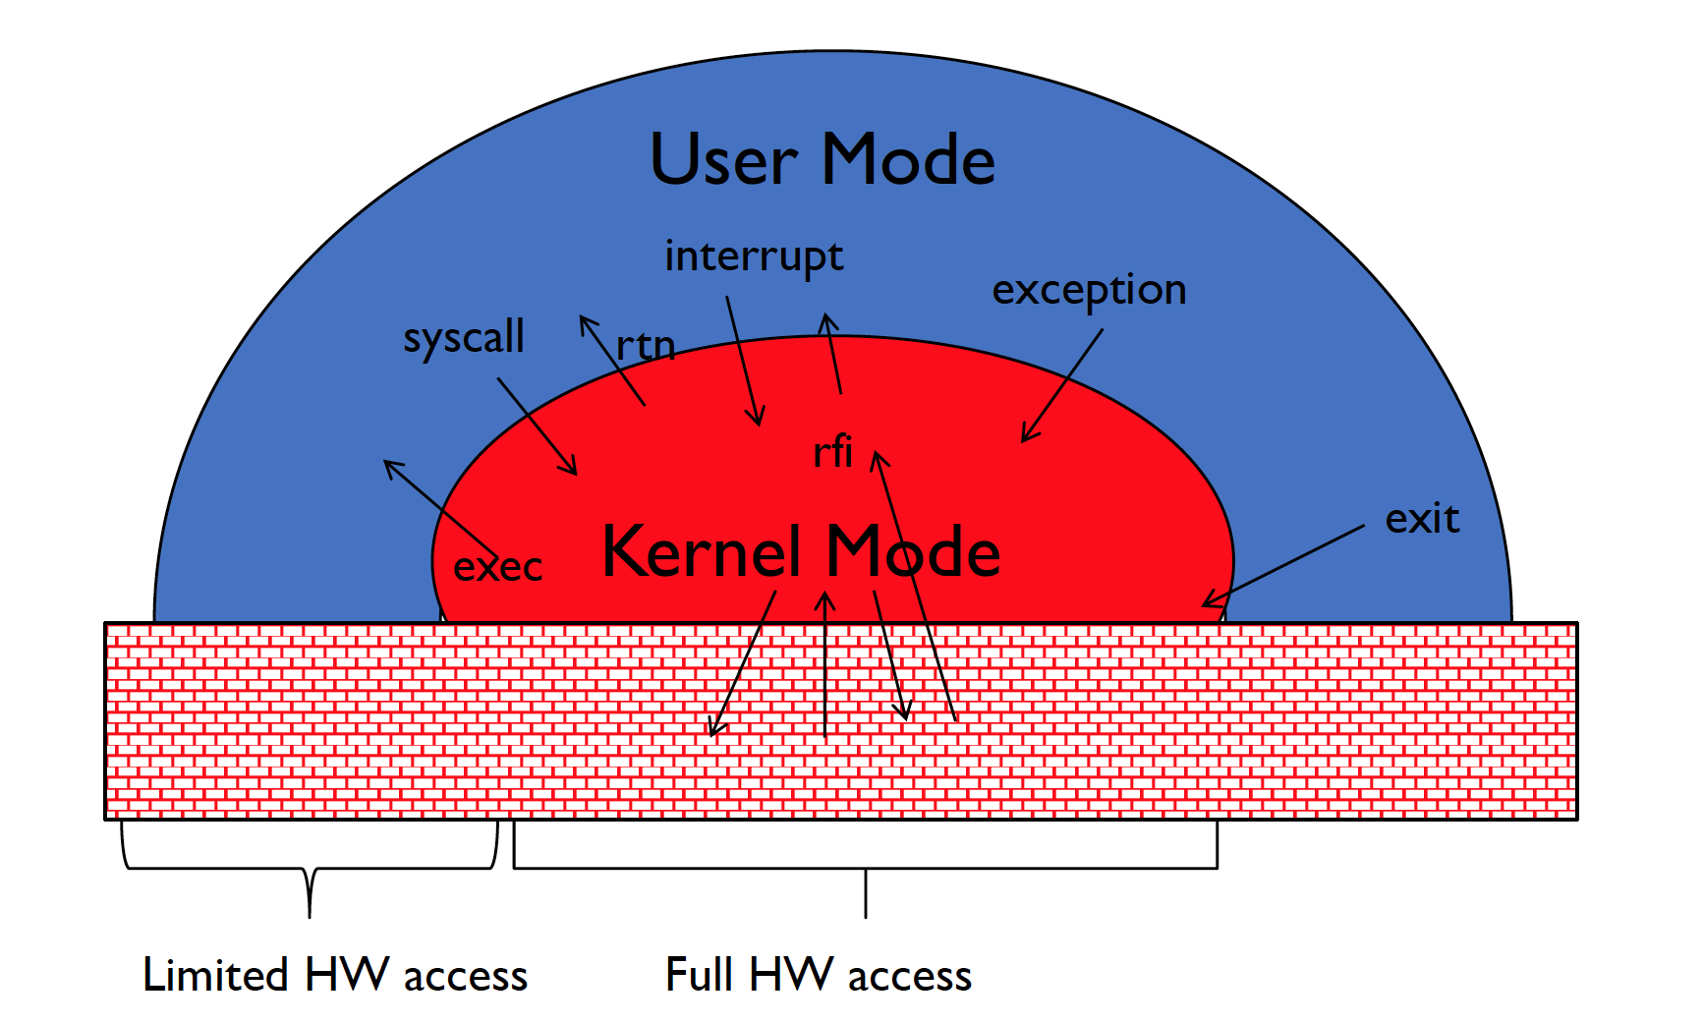
Mode Switches

Slide 6
Three Types of Mode Switches
System Calls
  Process requests a system service, e.g., exit
  Like a function call, but outside the process
  Do not have the address of the system function to call
Exceptions
  Internal synchronous event in process triggers context switch
  Protection violation (segmentation fault), Divide by zero, …
Interrupts
  External asynchronous event triggers context switch
  Timer, I/O device
  Independent of user process

Slide 7
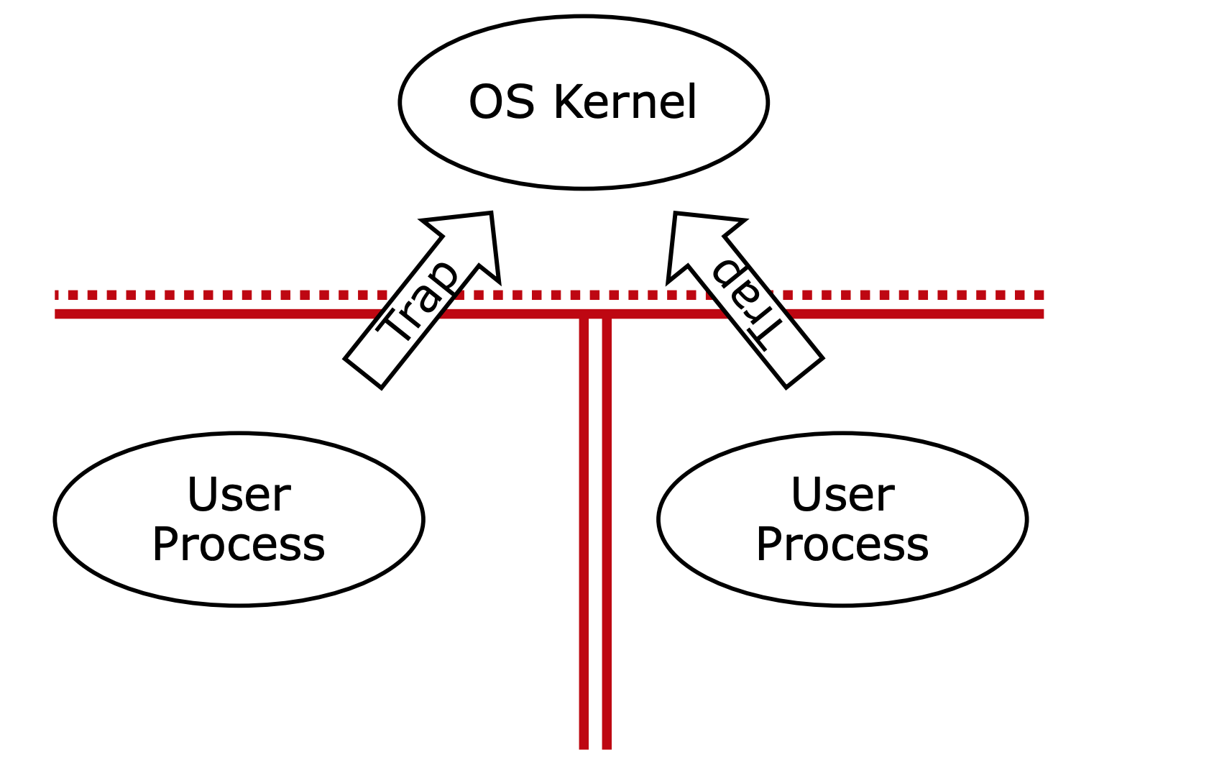
Protection for a Single OS

Slide 8
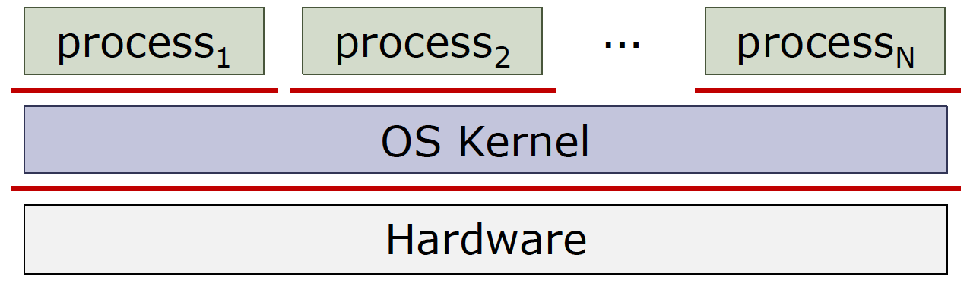
System Isolation in OS
Isolation between processes (Horizontal Isolation)
  Enforced by OS kernel
  Useful techniques: page tables, context switch, file abstraction…
Isolation between processes and the kernel (Vertical Isolation)
  CPU privilege and carefully designed interface

Slide 9
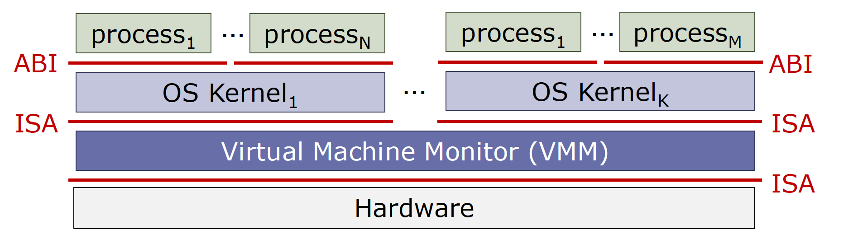
Virtual Machine Monitor
A VMM (aka Hypervisor) provides a system virtual machine to each OS
VMM can run directly on hardware (type-1) or on another OS (type 2)
Hardware virtualization
  VT-x: root and non-root mode
  EPT
  IOMMU and SR-IOV

Slide 10
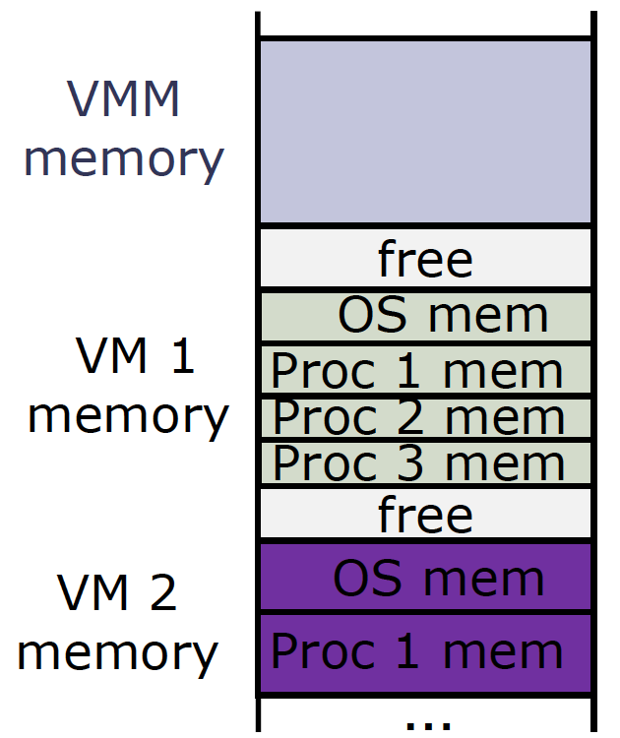
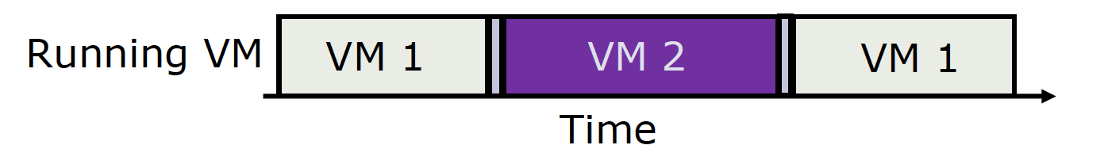
Virtual Machine (VM) Abstraction
Each VM has a private address space
  Provided by the hypervisor
  Cannot access other VM spaces
The hypervisor schedules processes into cores
  Each process has a scheduling time slice
A VM can invoke hypervisor services via hypercalls

Slide 11
Extended Page Table
Configured by the hypervisor
Three addresses
  Guest Virtual Address (GVA)
  Guest Physical Address (GPA)
  Host Physical Address (HPA)
From GVA to GPA
  Page Table: controlled by guest OS kernel
From GPA to HPA
  Extended Page Table: controlled by hypervisor

Slide 12
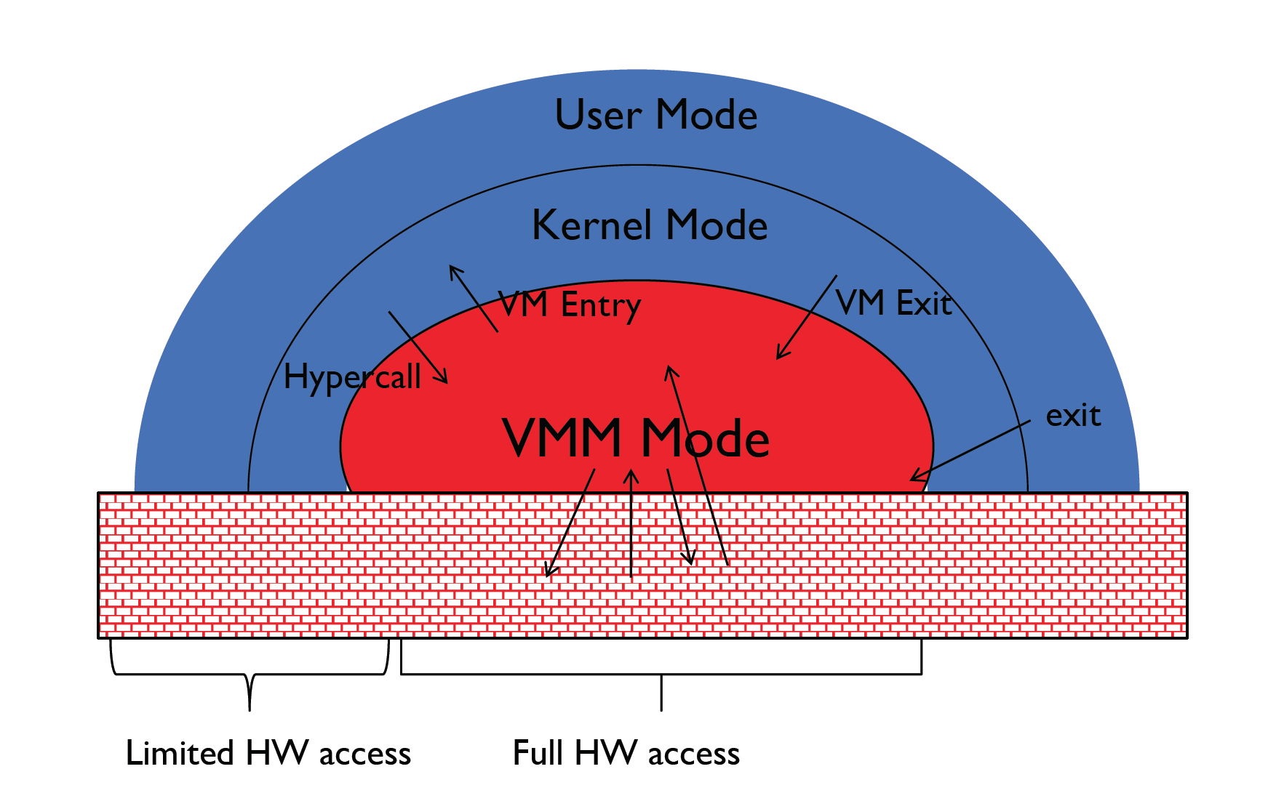
Mode Switches in VMM

Slide 13
VM Exits
VM Exits
  Any interrupt and exception may trigger a VM Exit
  Privileged instructions also cause VM Exits
  Modifying control registers, HLT instruction …
Hypercall
  A special kind of VM Exit
  Similar to system calls
  Internal synchronous event in VM to request hypervisor services
  Like a function call, but outside the VM
EPT Violation
  Another special kind of VM exit
  Similar to page fault
  Missing mappings or insufficient privileges in the EPT

Slide 14
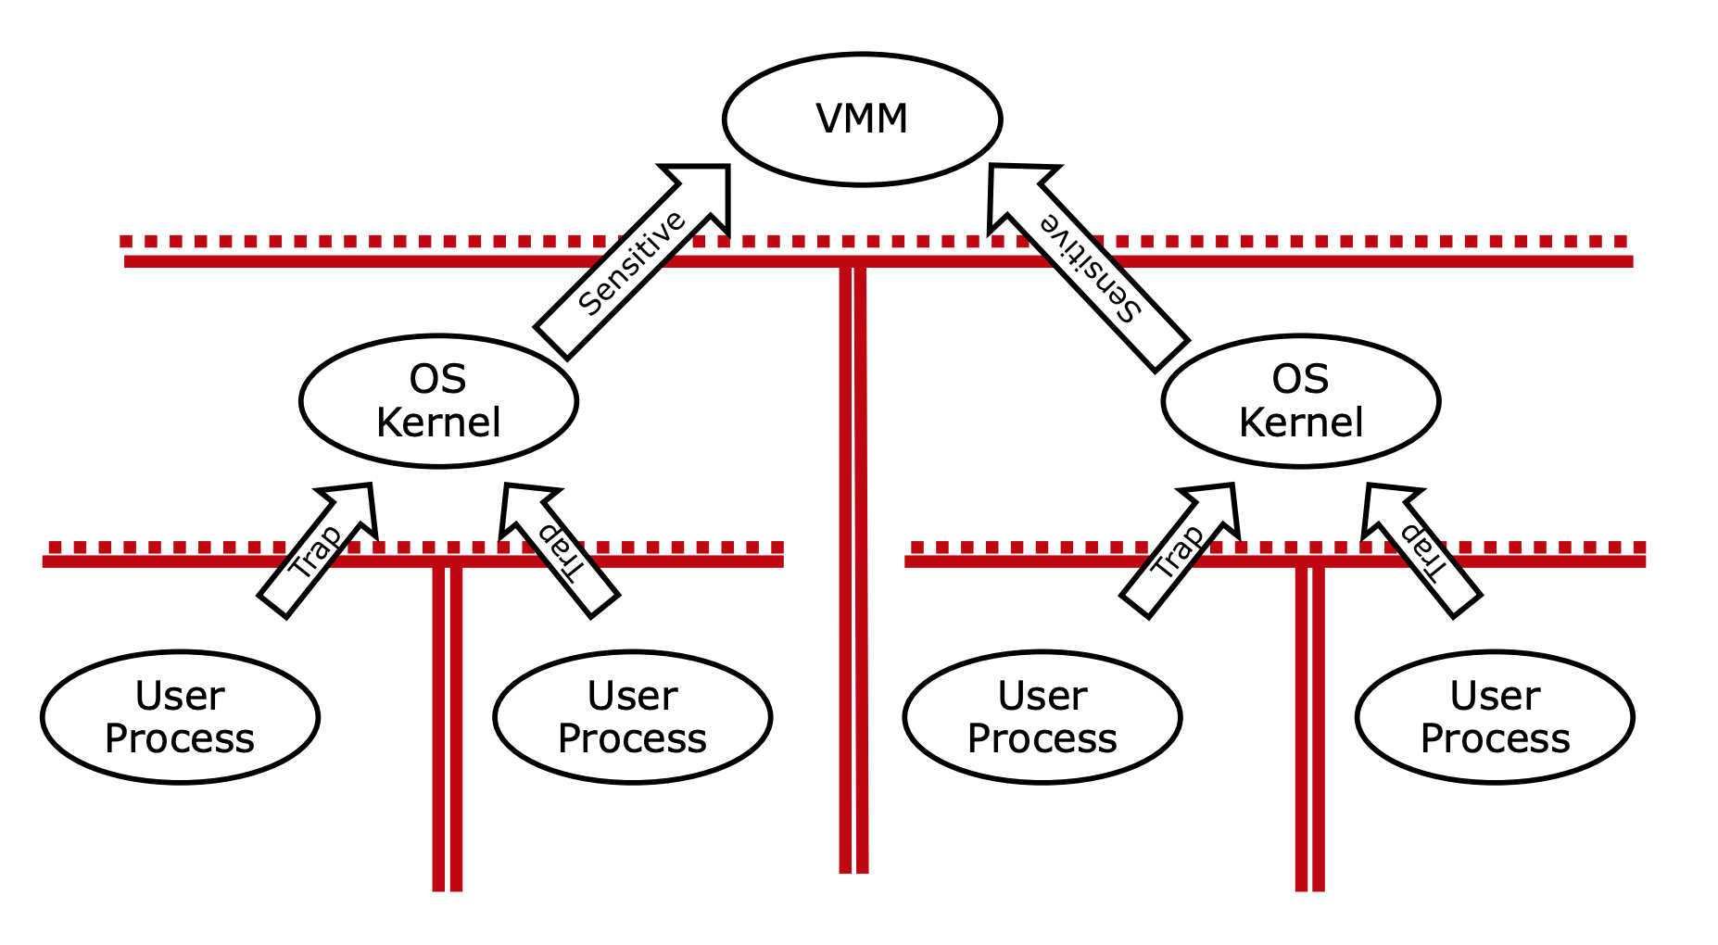
Protection for Multiple OSes

Slide 15
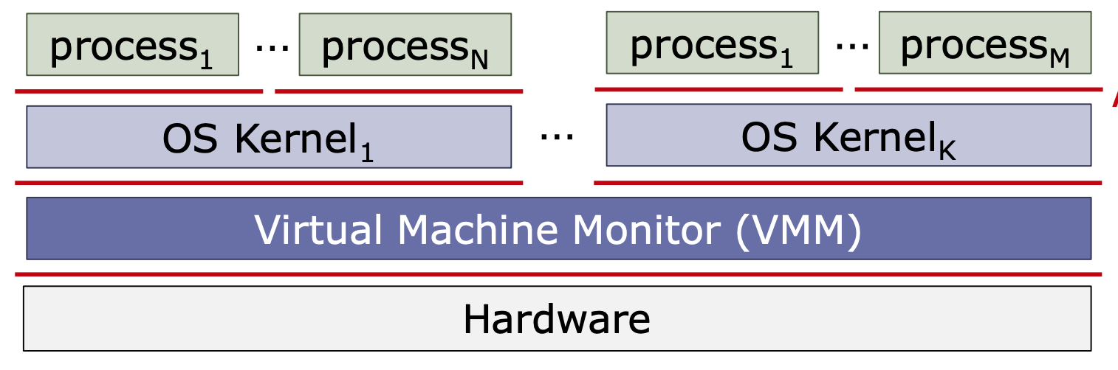
System Isolation in VMM
Isolation between OS kernels (Horizontal Isolation)
  Enforced by the VMM
  Useful techniques: EPTs
Isolation between OS kernels and VMM (Vertical Isolation)
  Hardware virtualization and carefully designed interface

Slide 16
Techniques for System Isolation
CPU privileges
Segmentation
Page table
Extended page table
Memory domain
Secure hardware modules

Slide 17
Techniques for System Isolation
CPU privileges
Segmentation
Page table
Extended page table
Memory domain
Secure hardware modules

Slide 18
CPU privileges
Ring 3
Processes
Privileged Mode
  Non-root Ring 0
  Root Ring 0
Operations in privileged mode
  Configure address spaces
  Access devices
  Read/write special registers
Ring 2
Non-root Mode
Ring 1
Ring 0
Guest Kernel
Ring 3
Root Mode
Ring 2
Ring 1
Ring 0
VMM

Slide 19
Techniques for System Isolation
CPU privileges
Segmentation
Page table
Extended page table
Memory domain
Secure hardware modules

Slide 20
Segmentation
offset
>
Error
Virtual
Address
Seg #
Offset
Base0
Limit0
V
Base1
Limit1
V
Base2
Limit2
V
Base2
Limit2
V
Physical
Address
Base3
Limit3
N
+
Base4
Limit4
V
Base5
Limit5
N
Base6
Limit6
N
Base7
Limit7
V
Check Valid
Segment map resides in processor
  Base added to offset to generate physical address
  Error check catches offset out of range
As many chunks of physical memory as entries
  Segment addressed by portion of virtual address
What is “V/N” (valid / not valid)?
  Can mark segments as invalid; requires check as well
Access
Error

Slide 21
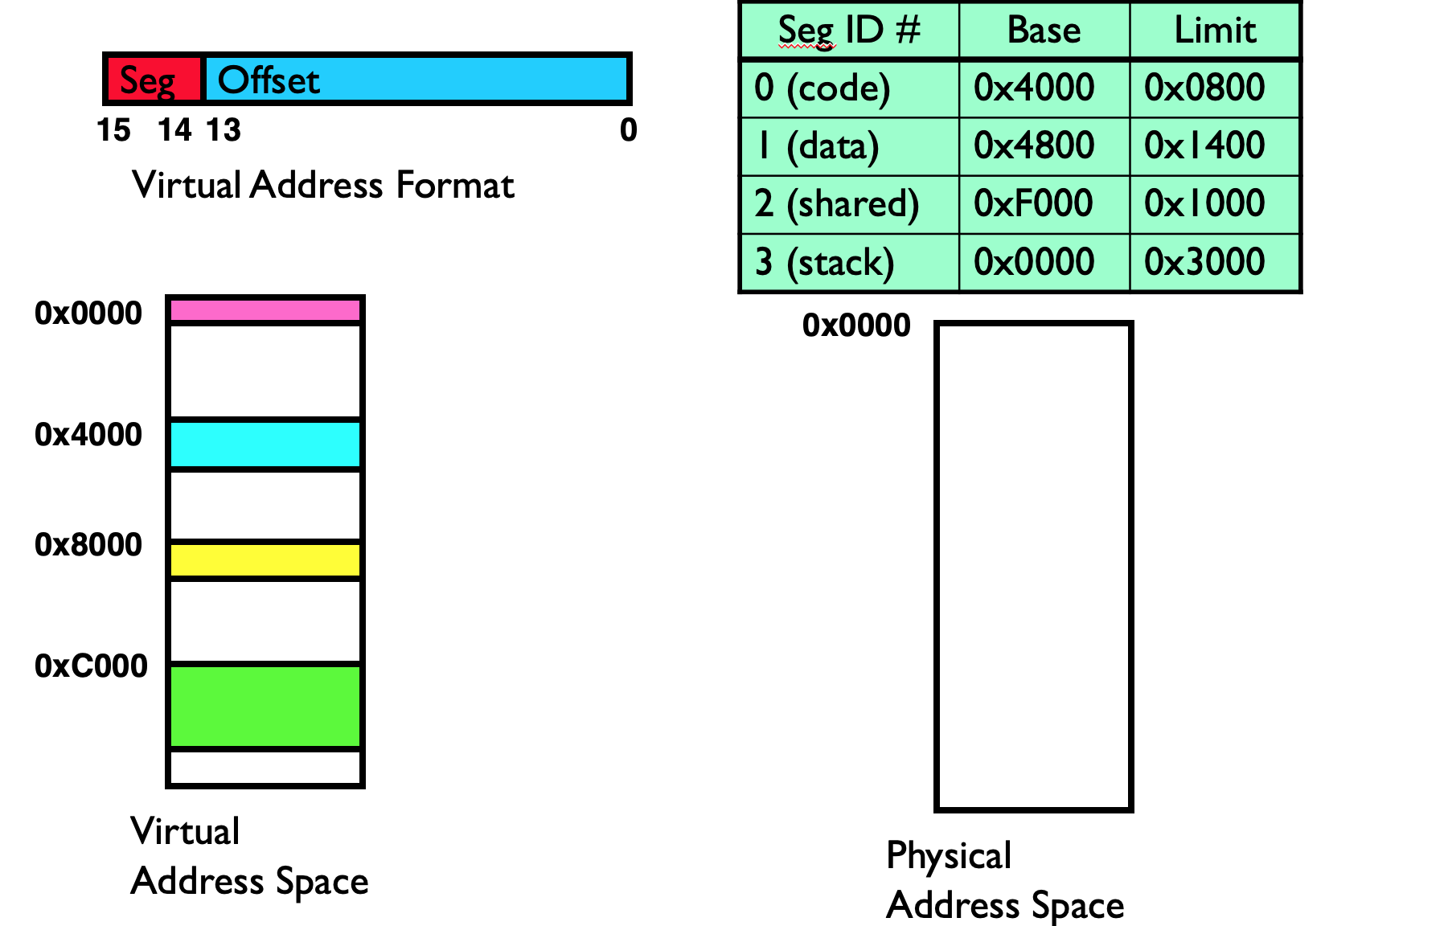

Slide 22
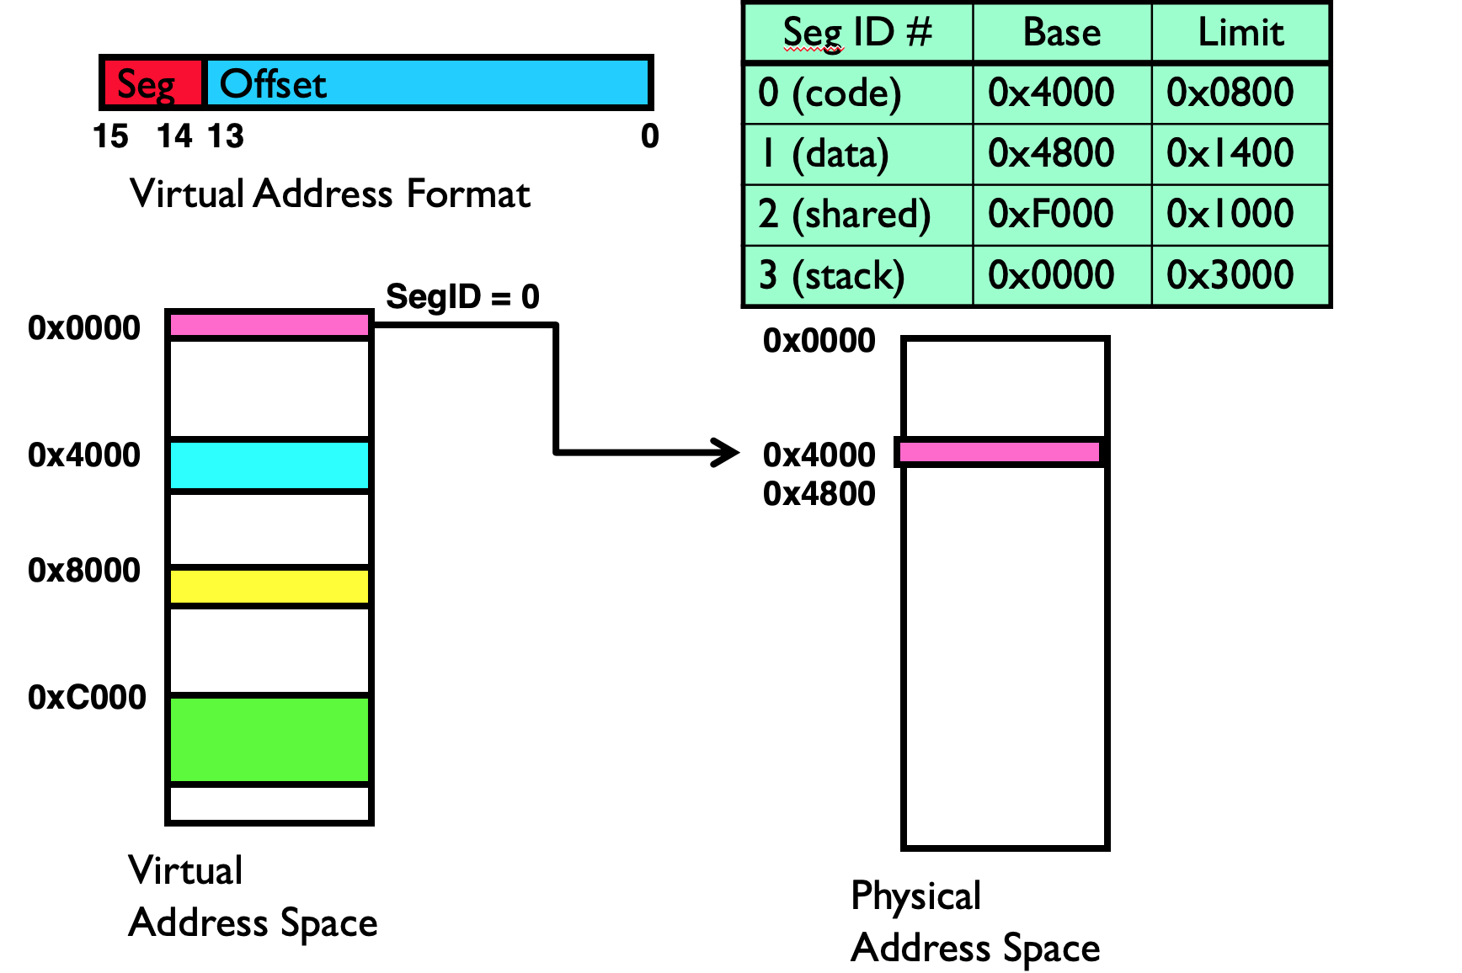

Slide 23
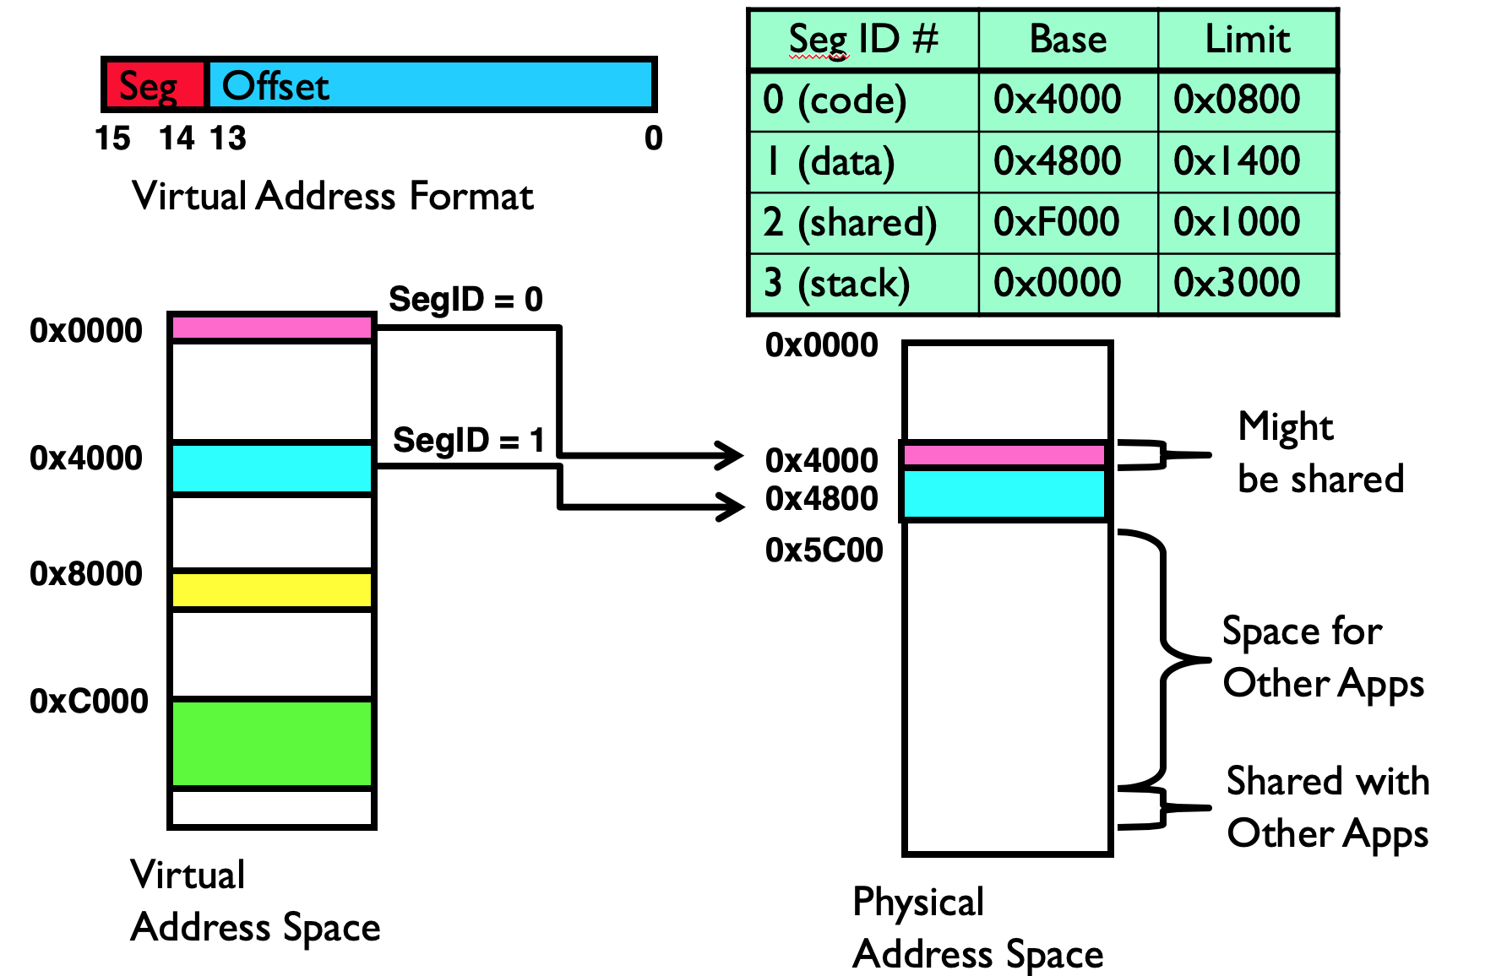

Slide 24
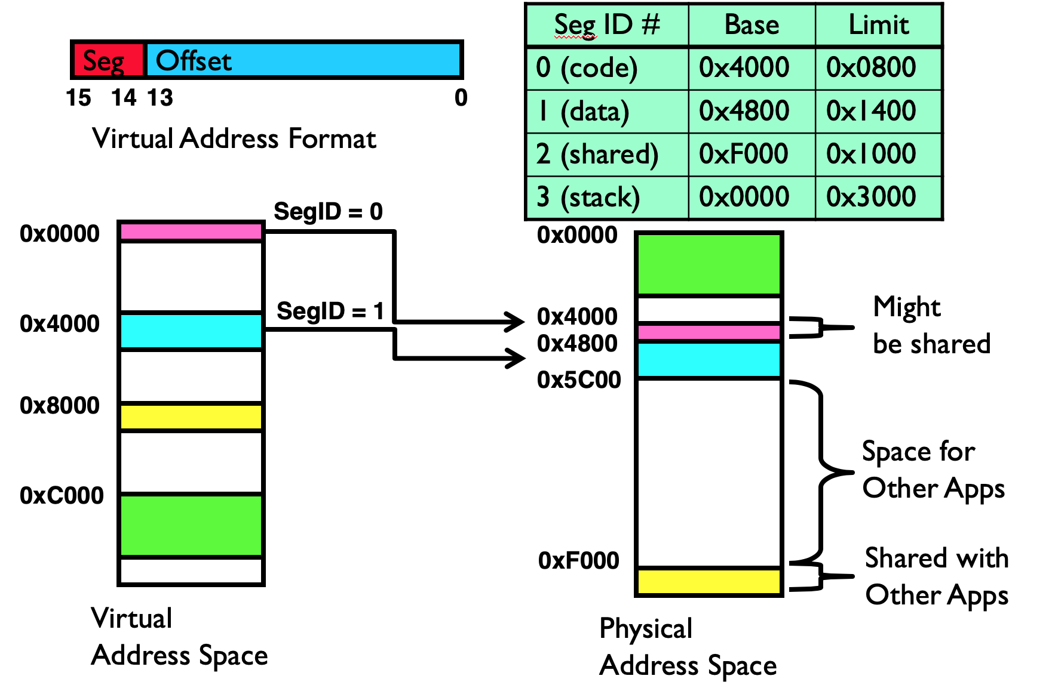

Slide 25
Problems with Segmentation
Not supported in x86-64 mode
Must fit variable-sized chunks into physical memory
Fragmentation: wasted space
  External: free gaps between allocated chunks
  Internal: do not need all memory within allocated chunks

Slide 26
Techniques for System Isolation
CPU privileges
Segments
Page table
Extended page table
Memory domain
Secure hardware modules

Slide 27
Hierarchical Page Table
Virtual Address
Index 1
Index 2
Index 3
Index 4
Offset
CR3
PGD
PUD
PMD
PTE
Physical Address
PFN
Offset

Slide 28
Techniques for System Isolation
CPU privileges
Segments
Page table
Extended page table
Memory domain
Secure hardware modules

Slide 29
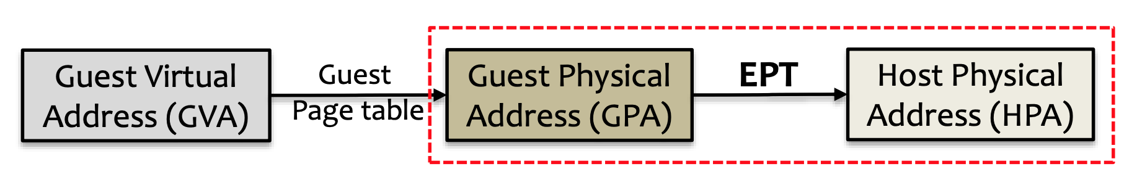
EPT
Translate guest physical addr to host physical addr
  The two-level translation are all done by hardware
EPT is manipulated and maintained by hypervisor
  Hypervisor controls how guest accesses physical address
  Any EPT violation triggers a VM Exit to hypervisor

Slide 30
Hierarchical Extended Page Table
GPA
Index 1
Index 2
Index 3
Index 4
Offset
EPT Pointer
L1E
L2E
L3E
L4E
HPA
PFN
Offset

Slide 31
Any GPA is translated to HPA
Virtual Address
Index 1
Index 2
Index 3
Index 4
Offset
CR3
PGD
PUD
PMD
GPA
PTE
EPT
HPA
Physical Address
PFN
Offset

Slide 32
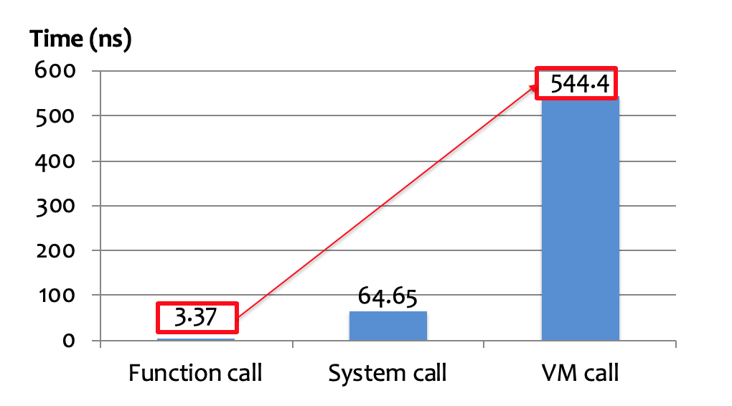
VMFUNC
Context switch introduces large overhead
  Every EPT switch is intervened by hypervisor
  A VM Exit takes much more time than function call

Slide 33
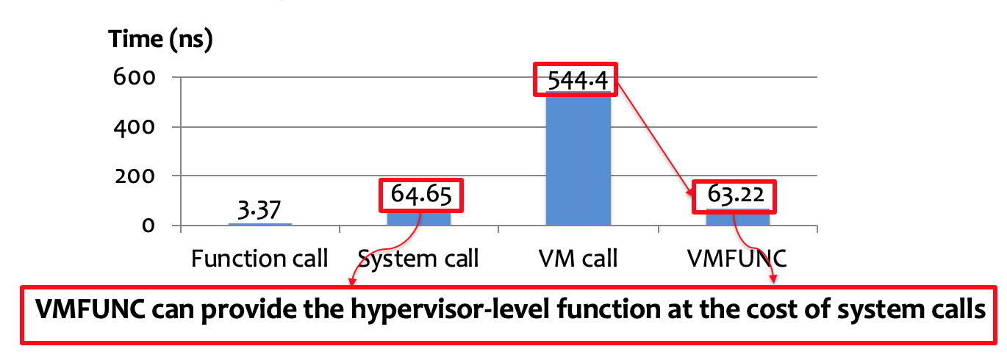
VMFUNC
VM Functions: Intel virtualization extension
  Non-root guest VMs can directly invoke some functions without VM Exit
VM Function 0: EPTP Switching
  Software in guest VM can directly load a new EPT pointer

Slide 34
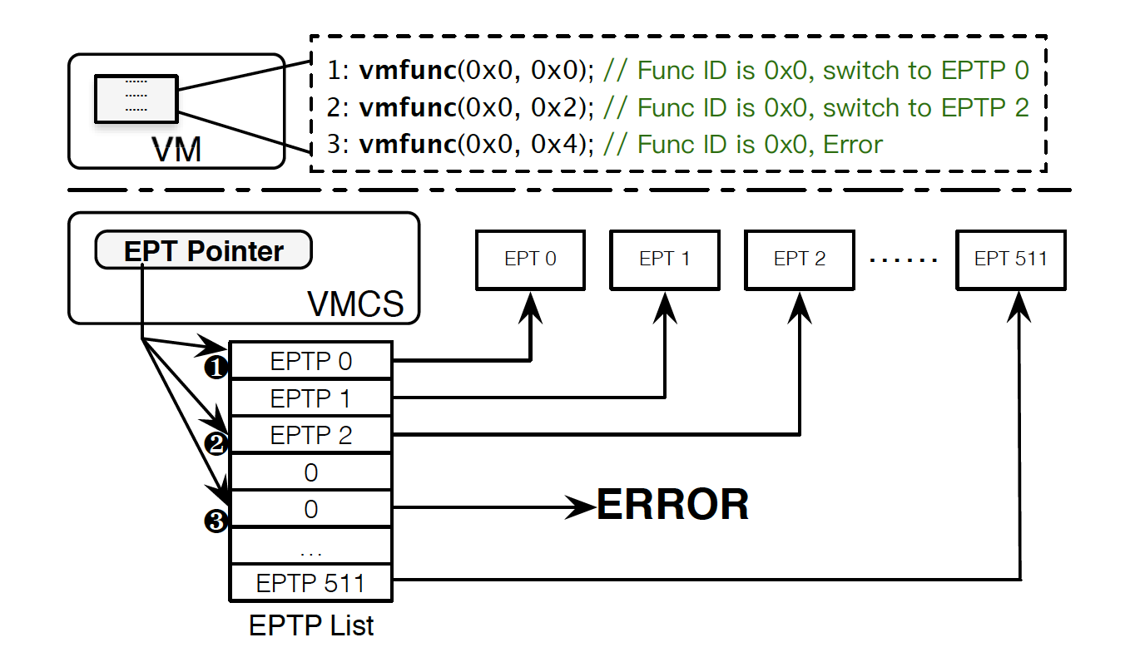
VMFUNC

Slide 35
Techniques for System Isolation
CPU privileges
Segments
Page table
Extended page table
Memory domain
Secure hardware modules

Slide 36
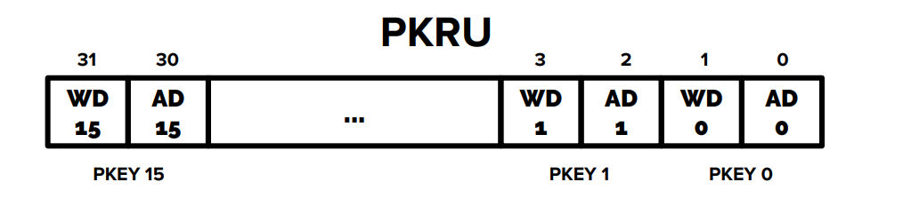
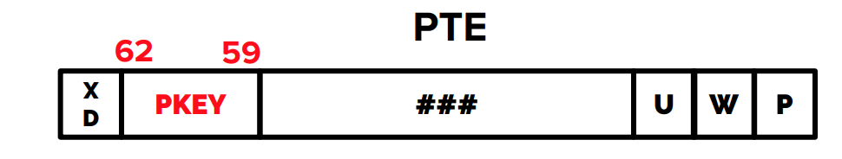
Intel Memory Protection Keys (MPK)
32-bit PKRU register (Access/Write Disable)
WRPKRU/RDPKRU

Slide 37
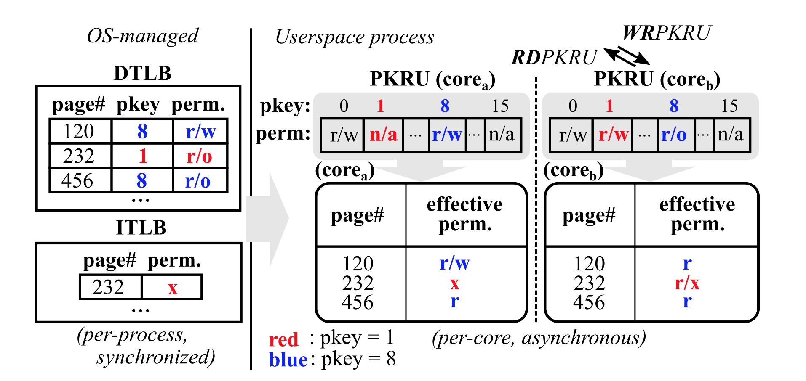
Intel Memory Protection Keys (MPK)

Slide 38
Techniques for System Isolation
CPU privileges
Segments
Page table
Extended page table
Memory domain
Secure hardware modules

Slide 39
Secure Hardware Modules
Many companies has released their secure hardware modules
  Intel SGX
  AMD SME/SEV
Encrypted memory for processes or VMs
  Privileged software cannot access these memory
Will be introduced in subsequent courses

Slide 40
Principles for System Isolation
Fine-grained isolation
Reduced attack surface
Small TCB and Reference monitor
Defense in depth
Proc 1
Proc 2
Proc 3
Proc 4
VM-1
VM-2
VMM
Hardware

Slide 41
Principles for System Isolation
Fine-grained isolation
Reduced attack surface
Small TCB and Reference monitor
Defense in depth

Slide 42
Fine-grained isolation
A process/kernel usually contains different modules
  Vulnerable modules and confidential ones
  Untrusted libraries and trusted libraries
These modules should have different privileges to the sensitive data
There is a need to provide fine-grained isolation

Slide 43
Fine-grained isolation
Many techniques can be leveraged to achieve this goal
  Page table
    Light-weight context (OSDI 2016)
  CPU privilege and Segmentation
    Lord of the x86 Rings (CCS 2018)
  EPT and VMFUNC
    SeCage (CCS 2015)
  MPK
    Hodor (ATC 2019)
Process
Process
Dom 1
Dom 2
Dom 1
Dom 2
OS Kernel
Hardware

Slide 44
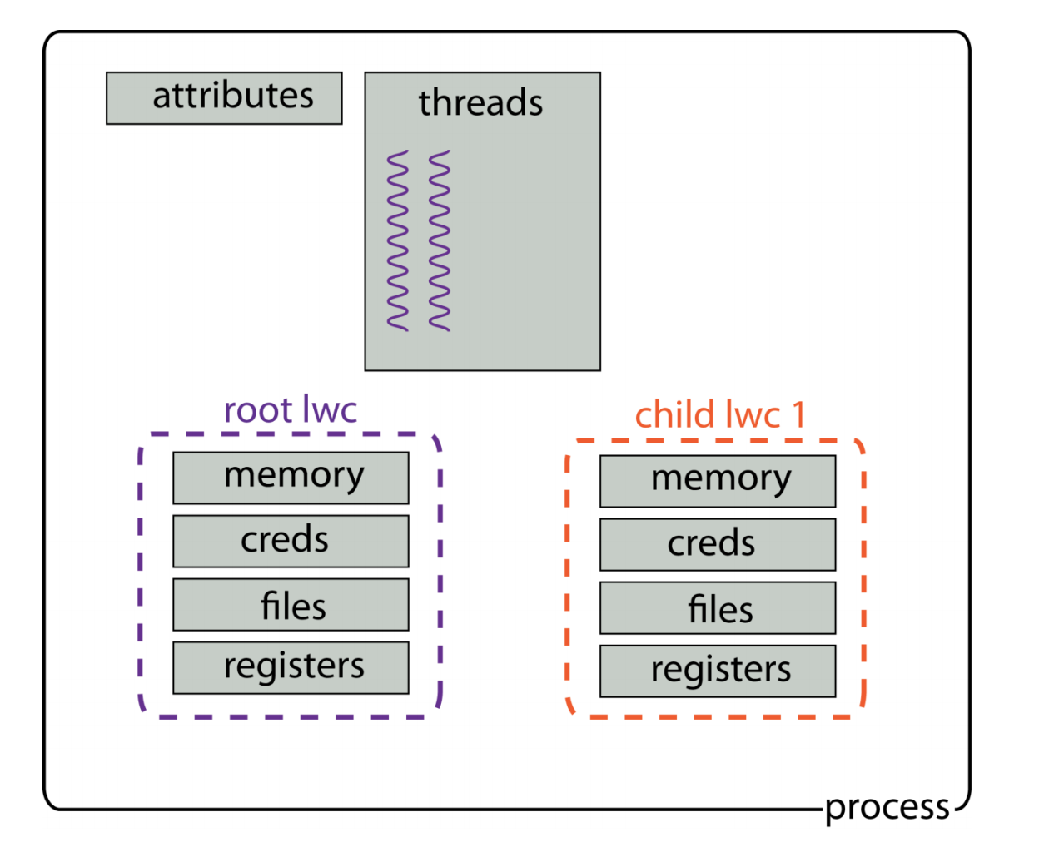
Light-Weight Context (LWC)
Multiple LWC for one process
Each LWC has a private page table
Switching LWC should get trapped into the kernel
  The kernel then changes related environment, including the page table

Slide 45
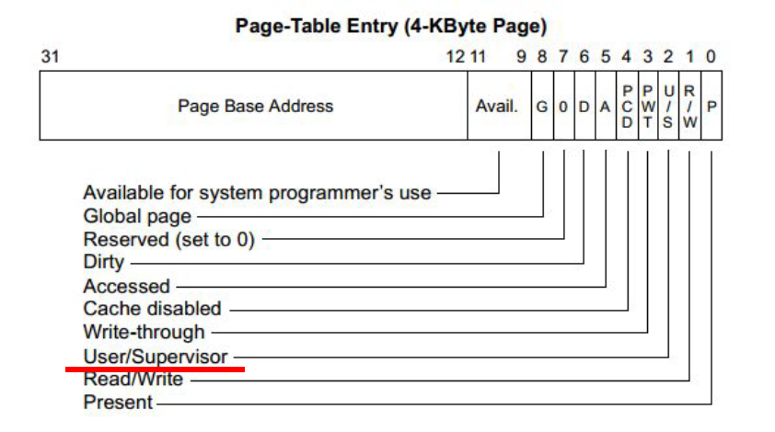
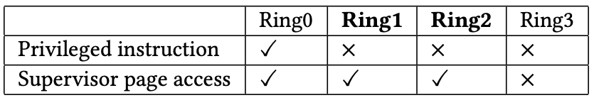
Lord of the x86 Rings
Switching LWC is slow
  Cost 6050 cycles in a Skylake CPU
Why not using CPU rings?
  Ring 0-2 can access supervisor pages
  Ring 3 cannot access these pages
  Only Ring 0 can execute privilege instructions

Slide 46
Lord of the x86 Rings
Put privileged user to ring 1 or ring 2
Map privileged user data and code to supervisor mode
Question
  What if the program in Ring 1 or Ring 2 is malicious?
  It can access kernel data or code!

Slide 47
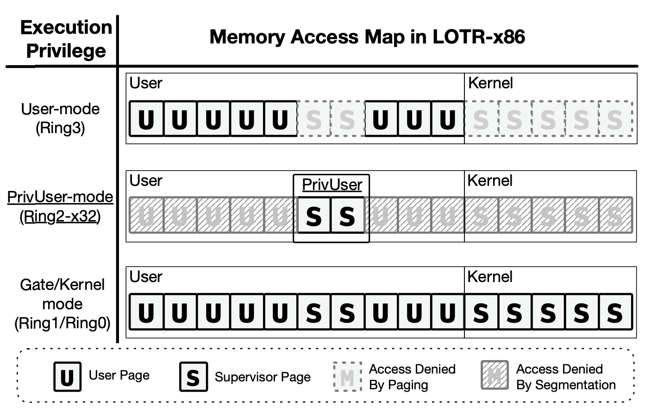
Segmentation to the Rescue

Slide 48
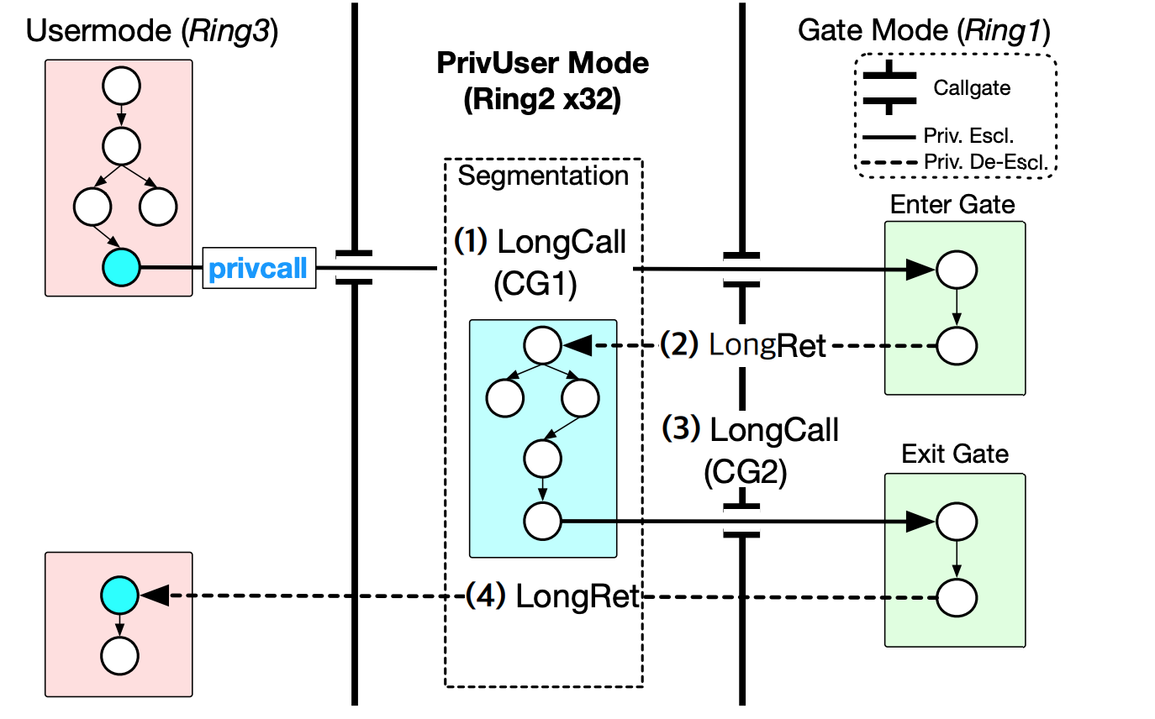
Lord of the x86 Rings
Notes:
X86-64不支持从64bit 模式跳到32bit的code segemnt上，所以不能同时实现到32bit和提升privilege。所以必须借助ring 1来先实现提权，再longret到32 bit上

Slide 49
SeCage
Application decomposition
APP
Decomposition
APP
Main Compartment
CODE
Secret Compartment
S Func
APP
Trampoline
Life-cycle Management
DATA
DATA
Operating System
Runtime Protection
Hypervisor
Memory Isolation
Initialization
Hardware

Slide 50
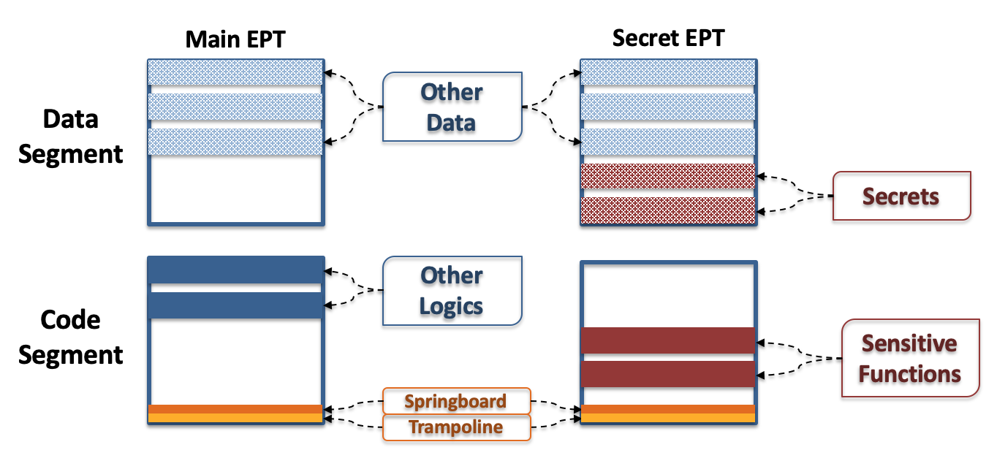
SeCage: Different EPTs for two Parts

Slide 51
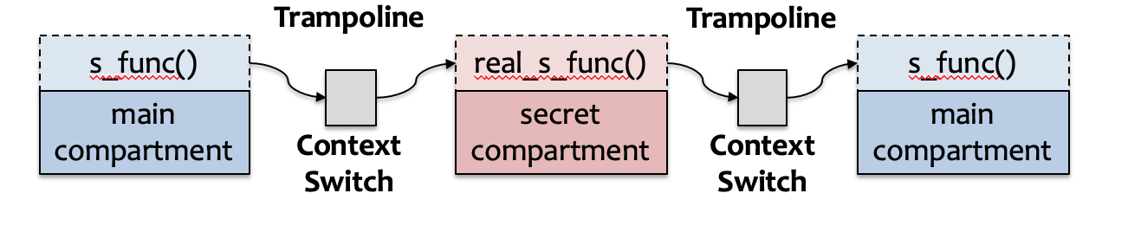
SeCage: Using VMFUNC to Switch EPTs
Trampoline control flow

Slide 52
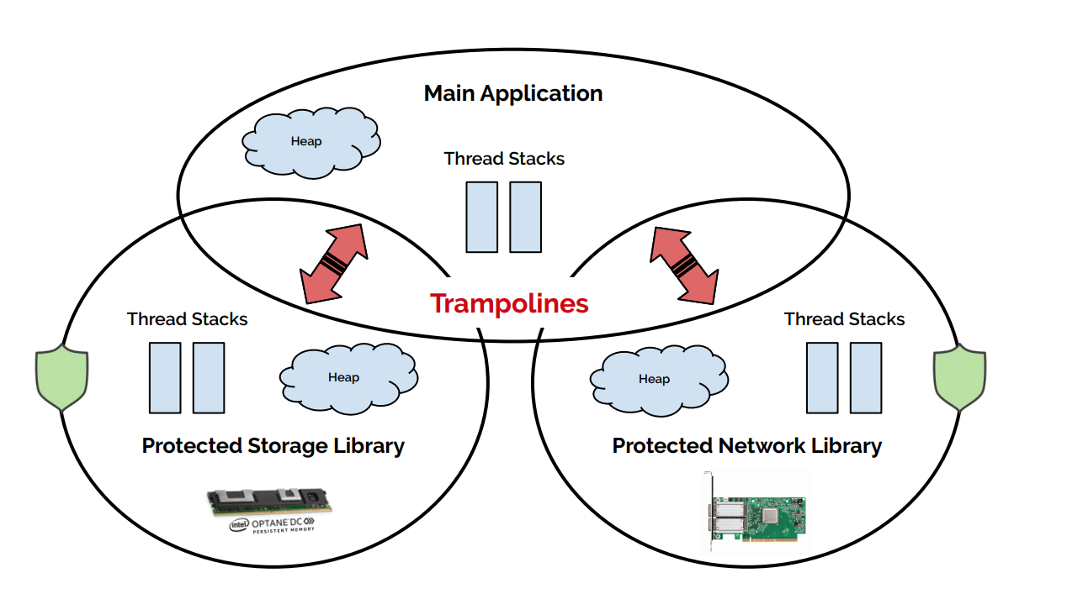
Hodor

Slide 53
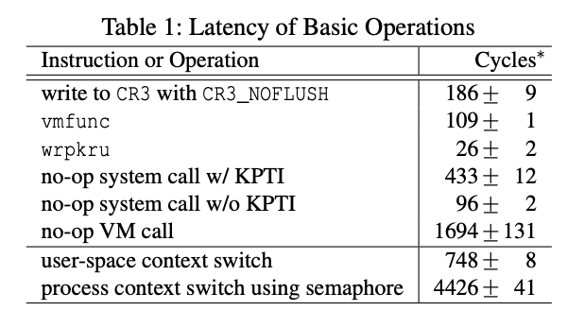
Hodor
Leverage MPK to provide different memory views
Have to replace illegal wrpkru instructions

Slide 54
Principles for System Isolation
Fine-grained isolation
Reduced attack surface
Small TCB and Reference monitor
Defense in depth

Slide 55
Reduced Attack Surface
Attack surface
  Points where an unauthorized user (the "attacker") can try to enter data to or extract data
  The interface between two entities
    API level
    System call level
    …
Keep attack surface as small as possible
  A fundamental isolation principle

Slide 56
Attack Surface
Interface number
  More than 350 system calls in Linux
  Only 10 hypercalls in KVM
  KVM has a much smaller attack surface if the call number matters
Invoked Code
  Small interface may cover a large number of code
Proc 1
Proc 2
Proc 3
Proc 4
VM-1
VM-2
VMM

Slide 57
Container
Lightweight virtualization: container
  Process isolation
  Namespace
  Cgroups
All containers share the same Linux kernel
Large attack surface
  System call

Slide 58
Container
Container
Container
Container
Apache
MySQL
Tomcat
Memcached
Ngnix
Redis
Namespace A
Namespace B
Namespace C
cgroup 1
cgroup 2
cgroup 3
Linux Kernel
Hardware

Slide 59


Container: Weak Isolation
Container
Container
Container
Apache
MySQL
Tomcat
Memcached
Ngnix
Redis
Namespace A
Namespace B
Namespace C
cgroup 1
cgroup 2
cgroup 3
Linux Kernel
Hardware

Slide 60
Hyper Container
Container
Container
Container
Apache
MySQL
Tomcat
Memcached
Nginx
Redis
Kernel
Kernel
Kernel
VMM
Hardware

Slide 61
Unikernel
Unikernel
Unikernel
Unikernel
Apache
MySQL
LibOS
Tomcat
Memcached
LibOS
Nginx
Redis
LibOS
VMM
Hardware

Slide 62
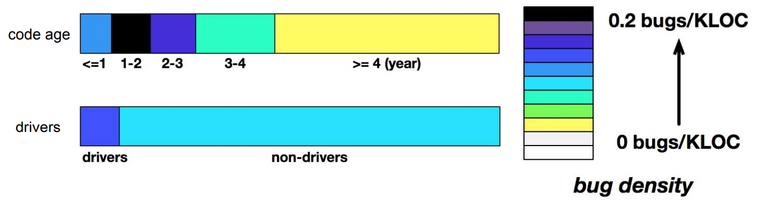
Bug Density in Linux Kernel
Bug density in Linux kernel

Slide 63
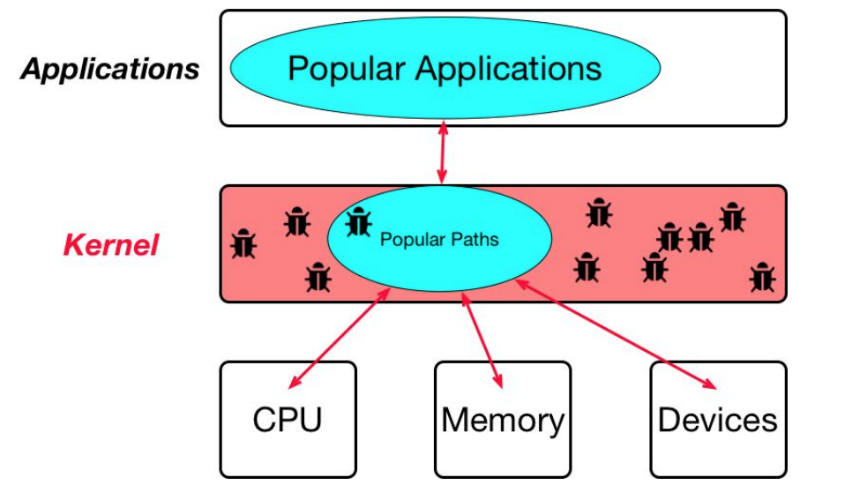
Popular Path
Definition
  lines of code in the kernel source files, which are commonly executed in the system’s normal workload
Key insight
  the popular paths contain many fewer bugs!

Slide 64
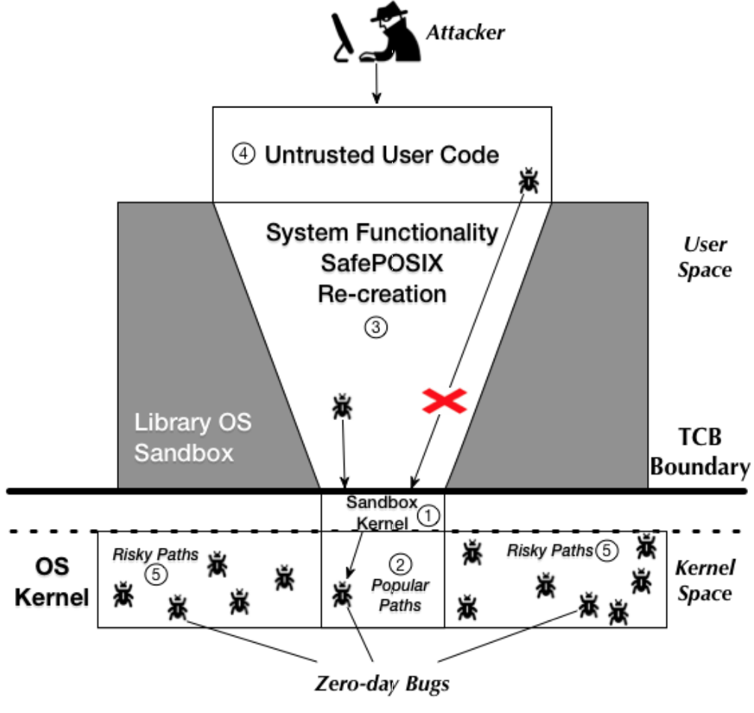
Lock-in-Pop
Lock applications into using only popular paths
Safely re-create file directories with basic calls like open(), read(), write(), close() to avoid using unpopular paths

Slide 65
Considering Timeline of a Process
Initialization phase
  Read configuration files
  Fork worker processes
  Execute other programs
  Create files and set their permissions
Serving phase
  Handle client requests
  Establish connections
  …

Slide 66
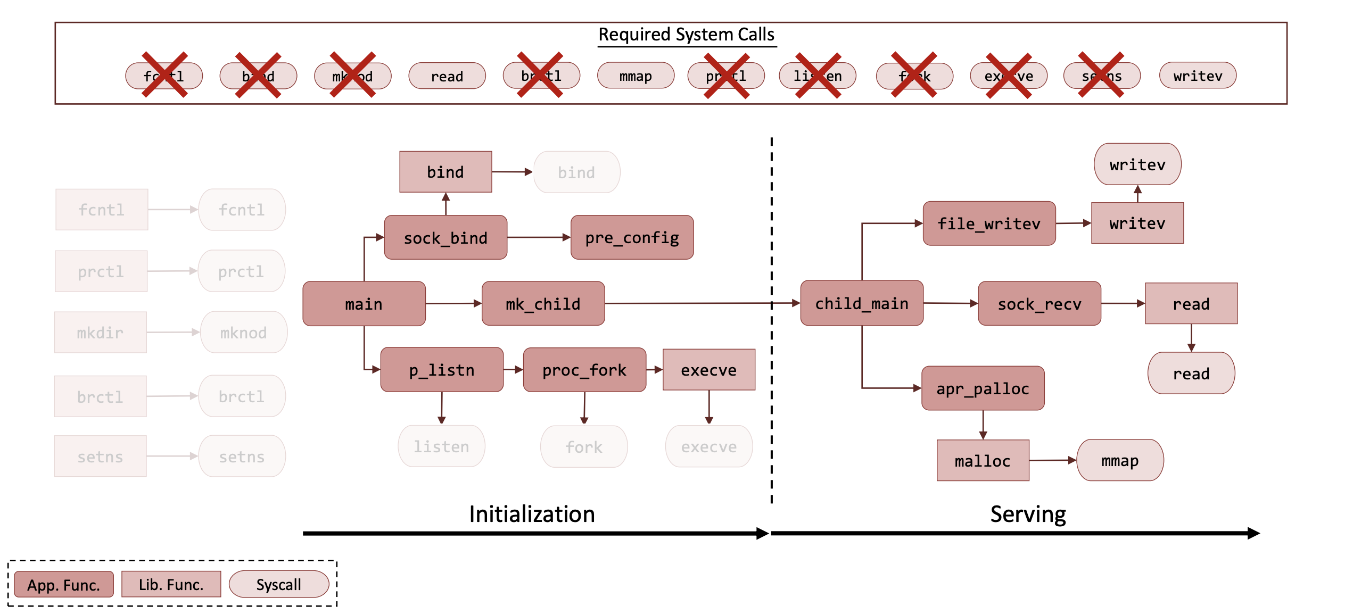
Example: Apache Web Server

Slide 67
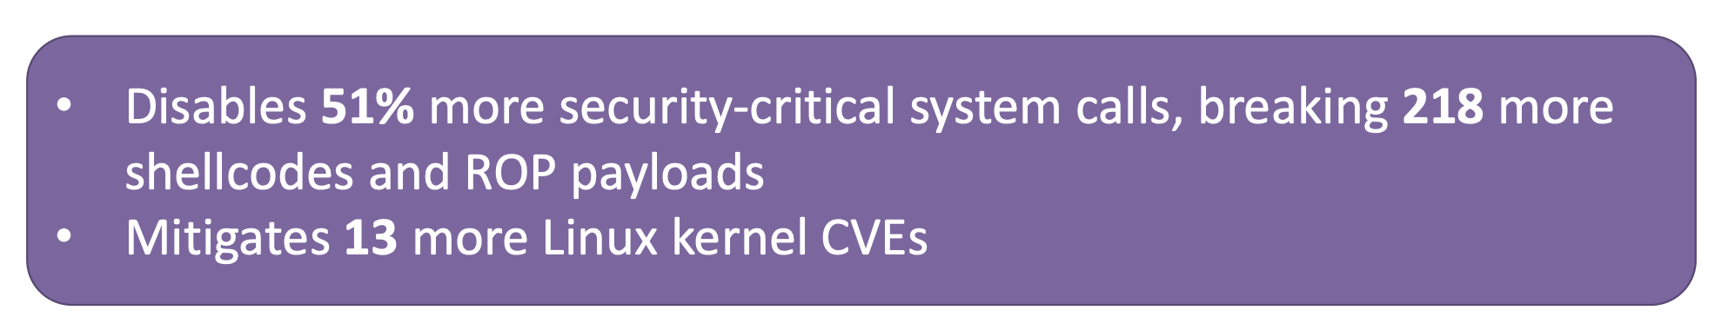
Temporal System Call Specialization
Disable additional system calls that are needed only during the initialization phase, after entering the serving phase

Slide 68
Principles for System Isolation
Fine-grained isolation
Reduced attack surface
Small TCB and Reference monitor
Defense in depth

Slide 69
TCB
The Trusted Computing Base (TCB)
  A trusted component is a part of the system that we rely upon to operate correctly
TCB lets us separate the system into two parts
  The part that is security-critical (the TCB)
  Everything else.

Slide 70
Reference Monitor
100% isolation is usually not what we want
We need controlled sharing/interaction as well
What does the guard do?
  Authenticate (验证身份)
  Authorize (授权)
  Audit (审计)
Separation policy from mechanism
  To ease reasoning
  To ease evolution of policy
Policy
Request
Principal
Guard
Resources
Audit Log

Slide 71
Reference Monitor
Reference monitor concept was defined in 1972 by James Anderson to describe design requirements on a “reference validation mechanism”
  The reference validation mechanism must always be invoked (complete mediation).
  The reference validation mechanism must be tamperproof (tamperproof).
  The reference validation mechanism must be small enough to be subject to analysis and tests, the completeness of which can be assured (verifiable).

Slide 72
Microkernel
Process
Process
Process
File
System
Device Driver
Application
Reference Monitor
Resources
Cap Table
Microkenrel
Hardware

Slide 73
Principles for System Isolation
Fine-grained isolation
Reduced attack surface
Small TCB and Reference monitor
Defense in depth

Slide 74
Defense in Depth
The notion of layering multiple types of protection together
Hypothesis is that attacker needs to breech all the defenses
But defense in depth isn't free:
  You are throwing more resources at the problem
  And although it can be better, it is less than the sum of the parts...

Slide 75
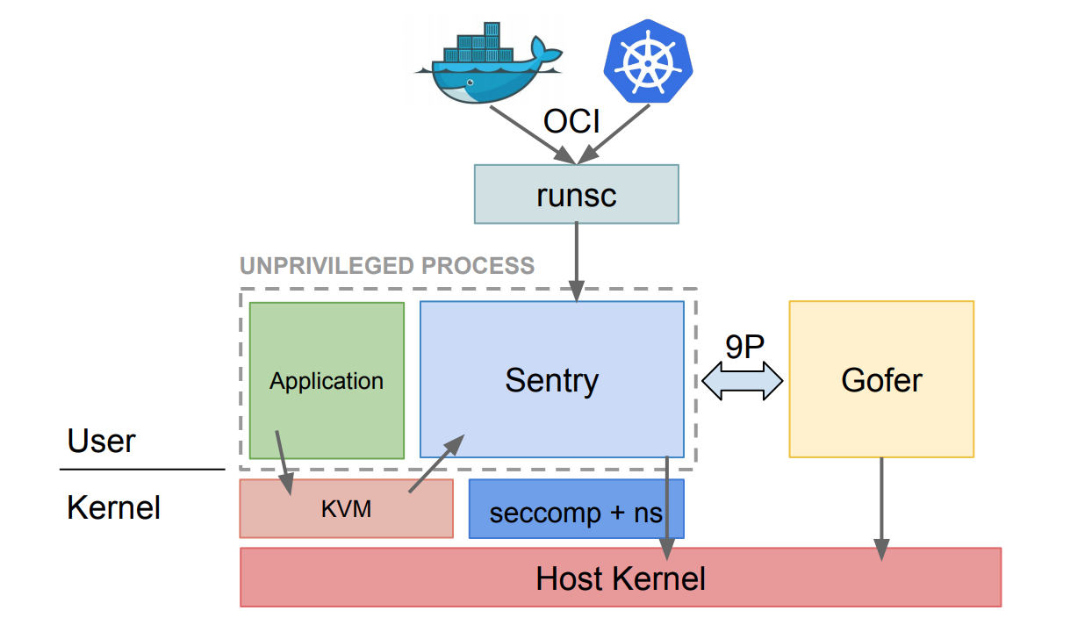
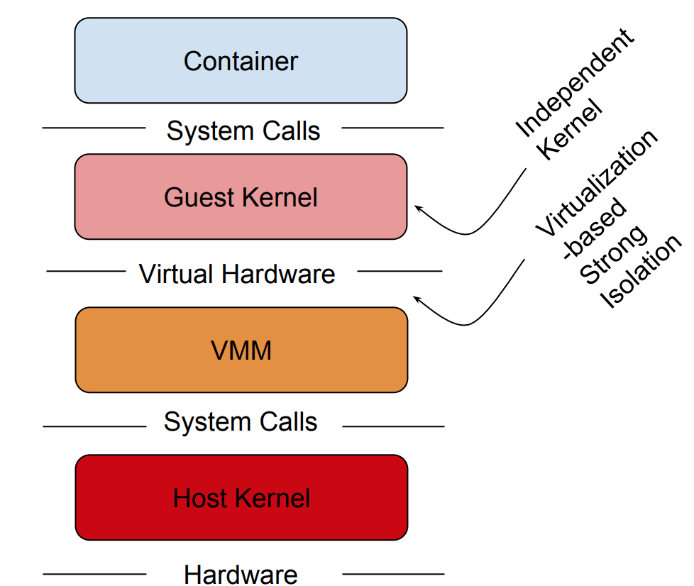
Google gVisor

Slide 76
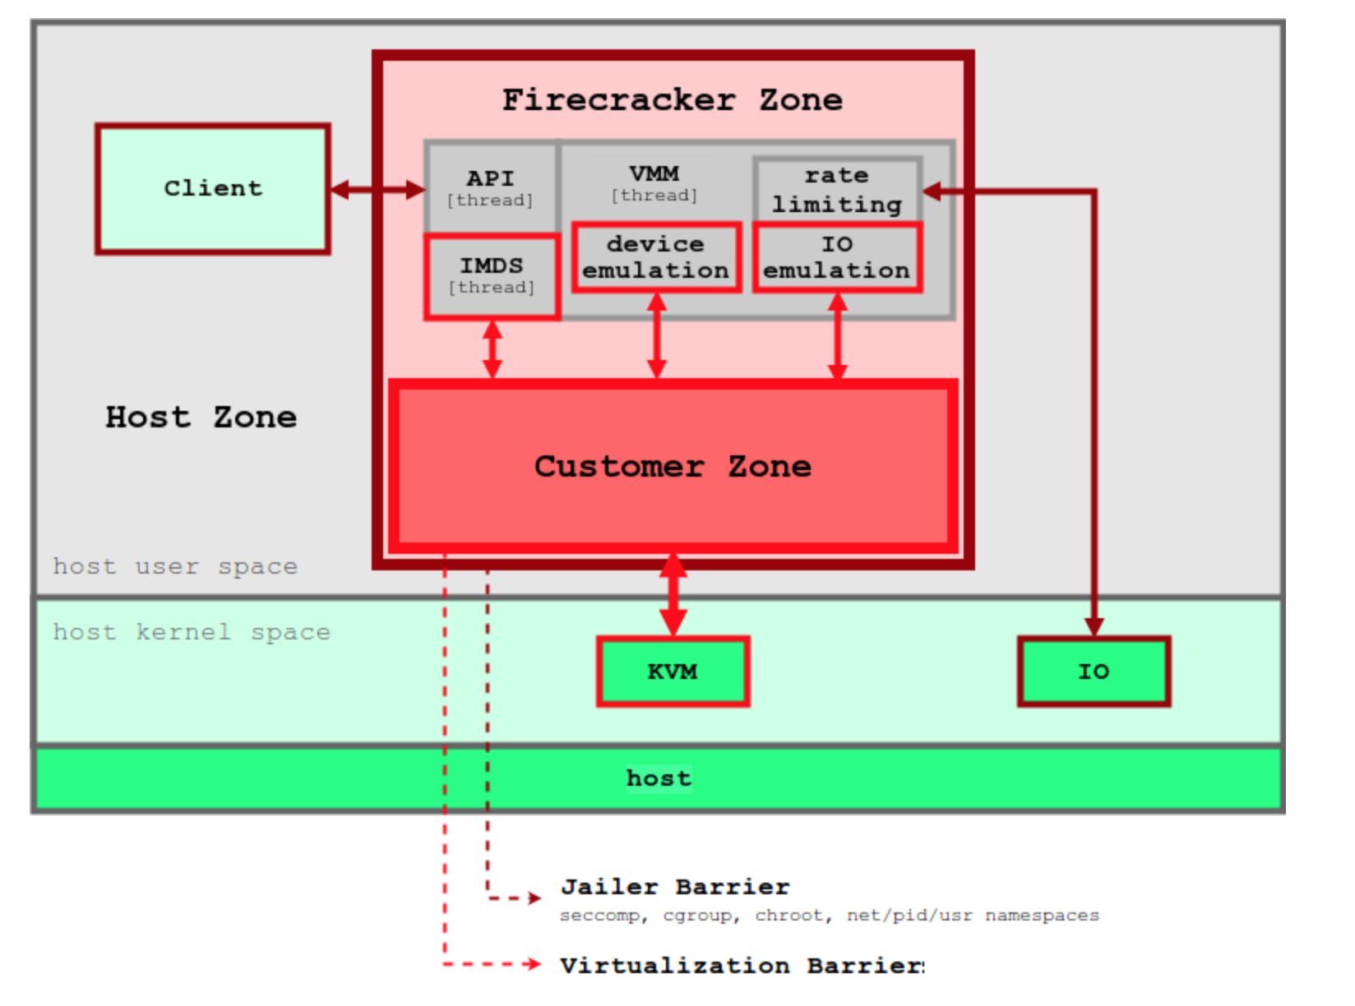
Amazon Firecracker

Slide 77
Principles for System Isolation
Fine-grained isolation
  Light-Weight Context
  Lord of the x86 Ring
  SeCage
  Hodor
Reduced attack surface
  Hyper Container
  Unikernel
  Lock-in-Pop
Small TCB and Reference monitor
  Microkernel
  Nested kernel
Defense in depth
  gVisor
  Firecracker
Proc 1
Proc 2
Proc 3
Proc 4
VM-1
VM-2
VMM
Hardware

Slide 78

Conclusion
What is system isolation?
Operating system and hypervisor
Isolation tools
Principles for system isolation
Thanks!

